Slide 1
Parts of the Periodic Table

Slide 2
Mendeleev & the Development of the Periodic Table
The original periodic table was developed by a Russian chemist named Dmitri Mendeleev
During the mid-1800’s there were about seventy known elements, which Mendeleev arranged in order of increasing atomic mass
Listing the elements in this order caused certain sets of properties to reoccur in a periodic pattern.
    NOTE: Periodic means to exhibit a repeating pattern.

Slide 3
Mendeleev & the Development of the Periodic Table
Mendeleev’s table left gaps for undiscovered elements, which allowed him to show how useful the table could be in predicting the existence and properties of unknown elements.
Problems?
  Co and Ni

Slide 4
Henry Moseley & the modern Periodic Table
Henry Moseley(1887-1915), an English physicist is responsible for the creation of the modern periodic table.
Instead of ordering the elements by increasing atomic mass, he arranged them by increasing atomic number.
Elements are still grouped by properties, with similar properties being in the same vertical column.
The new periodic table added a column of elements Mendeleev did not know about. The noble gases went unnoticed because of their inability to react with other elements.

Slide 5
Classifying the elements of the Periodic Table
One way to classify the elements on the periodic table is by the periods and groups to which they belong.
Periods
Periods are the horizontal rows on the periodic table and are number from 1-7.
Elements in the same period have consecutive atomic numbers, but they differ predictably in their chemical properties.
Groups
Groups or families are the vertical columns on the periodic table, numbered from 1A-8A. (1–18)
Elements in the same group usually have similar properties.

Slide 6
Groups labeled with an “A” are the representative elements.
The properties of the representative elements tend to be largely predictable based on their position in the periodic table.
1A
8A
2A
3A
6A
8A
4A
5A
7A
3A
4A
5A
6A
7A
Notes:
Have Students label groups according to the ppt slide

Slide 7
The groups labeled with “B” are the transition elements.
The properties of the transition elements are less predictable than those of the representative elements.
  Some transition metals exist in nature as free compounds. EX: Gold (Au) & Silver (Ag)
B
The horizontal groups located below the main body of the periodic table are called the inner transition elements. They are normally removed to save space.
Notes:
Have students label the “B” Group elements as transition metals

Slide 8
Group Names
Chemist gave four representative groups special names.
    Group 1A are the alkali metals
    Group 2A are the alkaline earth metals
    Group 7A is called the Halogens
    Group 8A are the noble gases
Notes:
Have students color and label the specific names of the 4 groups listed

Slide 9
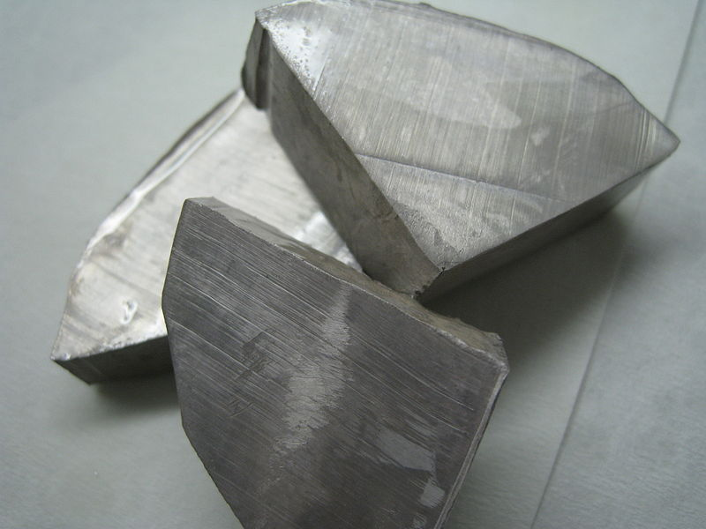
Alkali Metals
In their pure state, alkali metals have a silvery appearance and are soft enough to cut with a knife.
They are very reactive so they cannot be found in nature as free elements.
    EX: Sodium (Na) is a very reactive metal. It violently explodes when it has contact with water.
        Sodium Metal
        Proceeding down the column they melt at successively lower temperatures

Slide 10
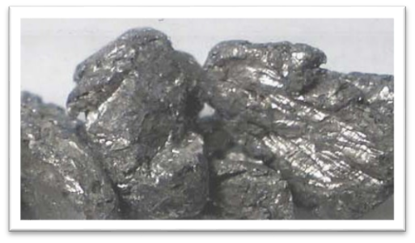
Alkali Earth Metals
Alkaline Earth Metals are harder, denser, and stronger than alkali metals. They also have higher melting points. (Remember: Melting Point is an intensive property. It stays the same, no matter how much of a substance you have.)
Although less reactive than alkali metals, they are still too reactive to be found in nature as free elements.
    EX: Calcium (Ca) will react vigorously upon contact with water, but will not explode like sodium.
  Calcium Metal

Slide 11
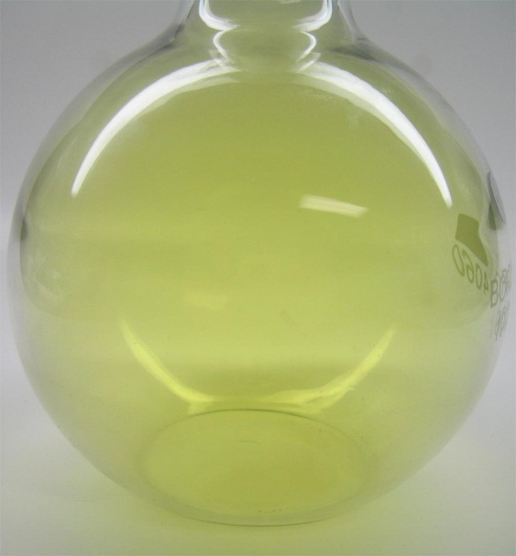
Halogens
The Halogen gases are the most reactive nonmetals.
They react vigorously with most metals to form compounds known as salts
  EX: Chlorine (Cl) reacts with Sodium (Na) to create the compound NaCl, or what we know as table salt.
Chlorine
Gas

Slide 12
Noble Gases
Noble gases are chemically inert. They do not react with other elements on the periodic table.
EX: Helium (He) is a chemically stable element because its highest electron shell is full. Since it does not react with other elements it is safe for us to put into balloons.
It is the goal of every element on the periodic table to be like the noble gases.

Slide 13
Dividing the Periodic Table
Another way to classify the elements is to divide them into three groups:
Metals
Metalloids
Non-Metals
Notes:
Have students divide table into these 3 groups. Outline sections on their table

Slide 14
Metals & their Physical Properties
Metals
Located on the left side of the periodic table have the following physical properties:
They are solids (with the exception of mercury).
They have a metallic lustre.
They are good conductors of heat and electricity.
They are malleable, or capable of being hammered into thin sheets.
They are ductile, or capable of being drawn into thin wire.
As we will discuss later, metals tend to lose electrons in chemical reactions to achieve the same number of electrons as the nearest noble gas.

Slide 15
Metalloids
The elements bordering the stair stepped line are called the metalloids.
    Boron (B), Silicon (Si), Germanium (Ge), Arsenic (As),
Antimony(Sb), Tellurium (Te)
They are mostly brittle solids with properties of both metals and nonmetals.
They have unusually good electrical conductivity that make them valuable for the computer & semiconductor industry.

Slide 16
Non-metals & Their properties
Non-metals
Non- Metals are located to the right of the periodic table.
    CAUTION: Be careful not to confuse Hydrogen as a metal. It is still a non-metal even though it’s on the left side of the periodic table.
Non-metals have properties that are the opposite of metals.
    Many are not solid.
    They have a dull lustre
    They are not conductors of heat & electricity
    They are not malleable or ductile.
    Non-metals tend to gain electrons in chemical reactions to gain the same number of electrons as the nearest noble gas.

